Slide 1

Diagnostic Residential Project: making nematological upskilling possible!
Duy Le
Cotton Pathologist
NSW Department of Primary Industries

Slide 2

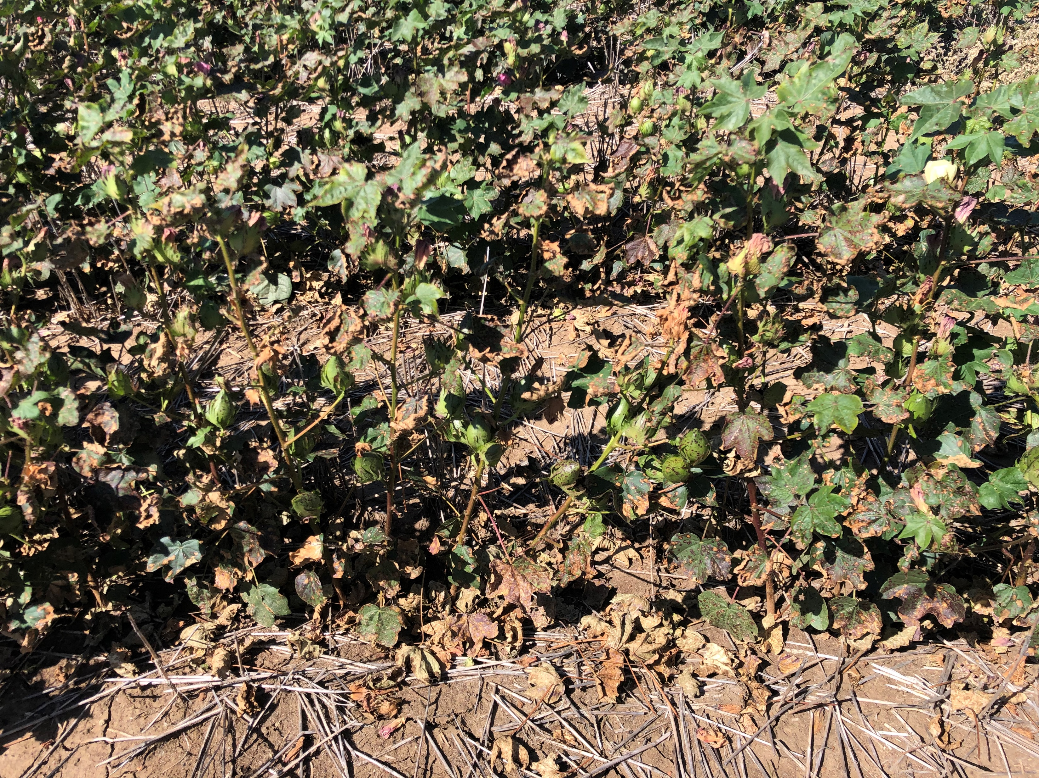
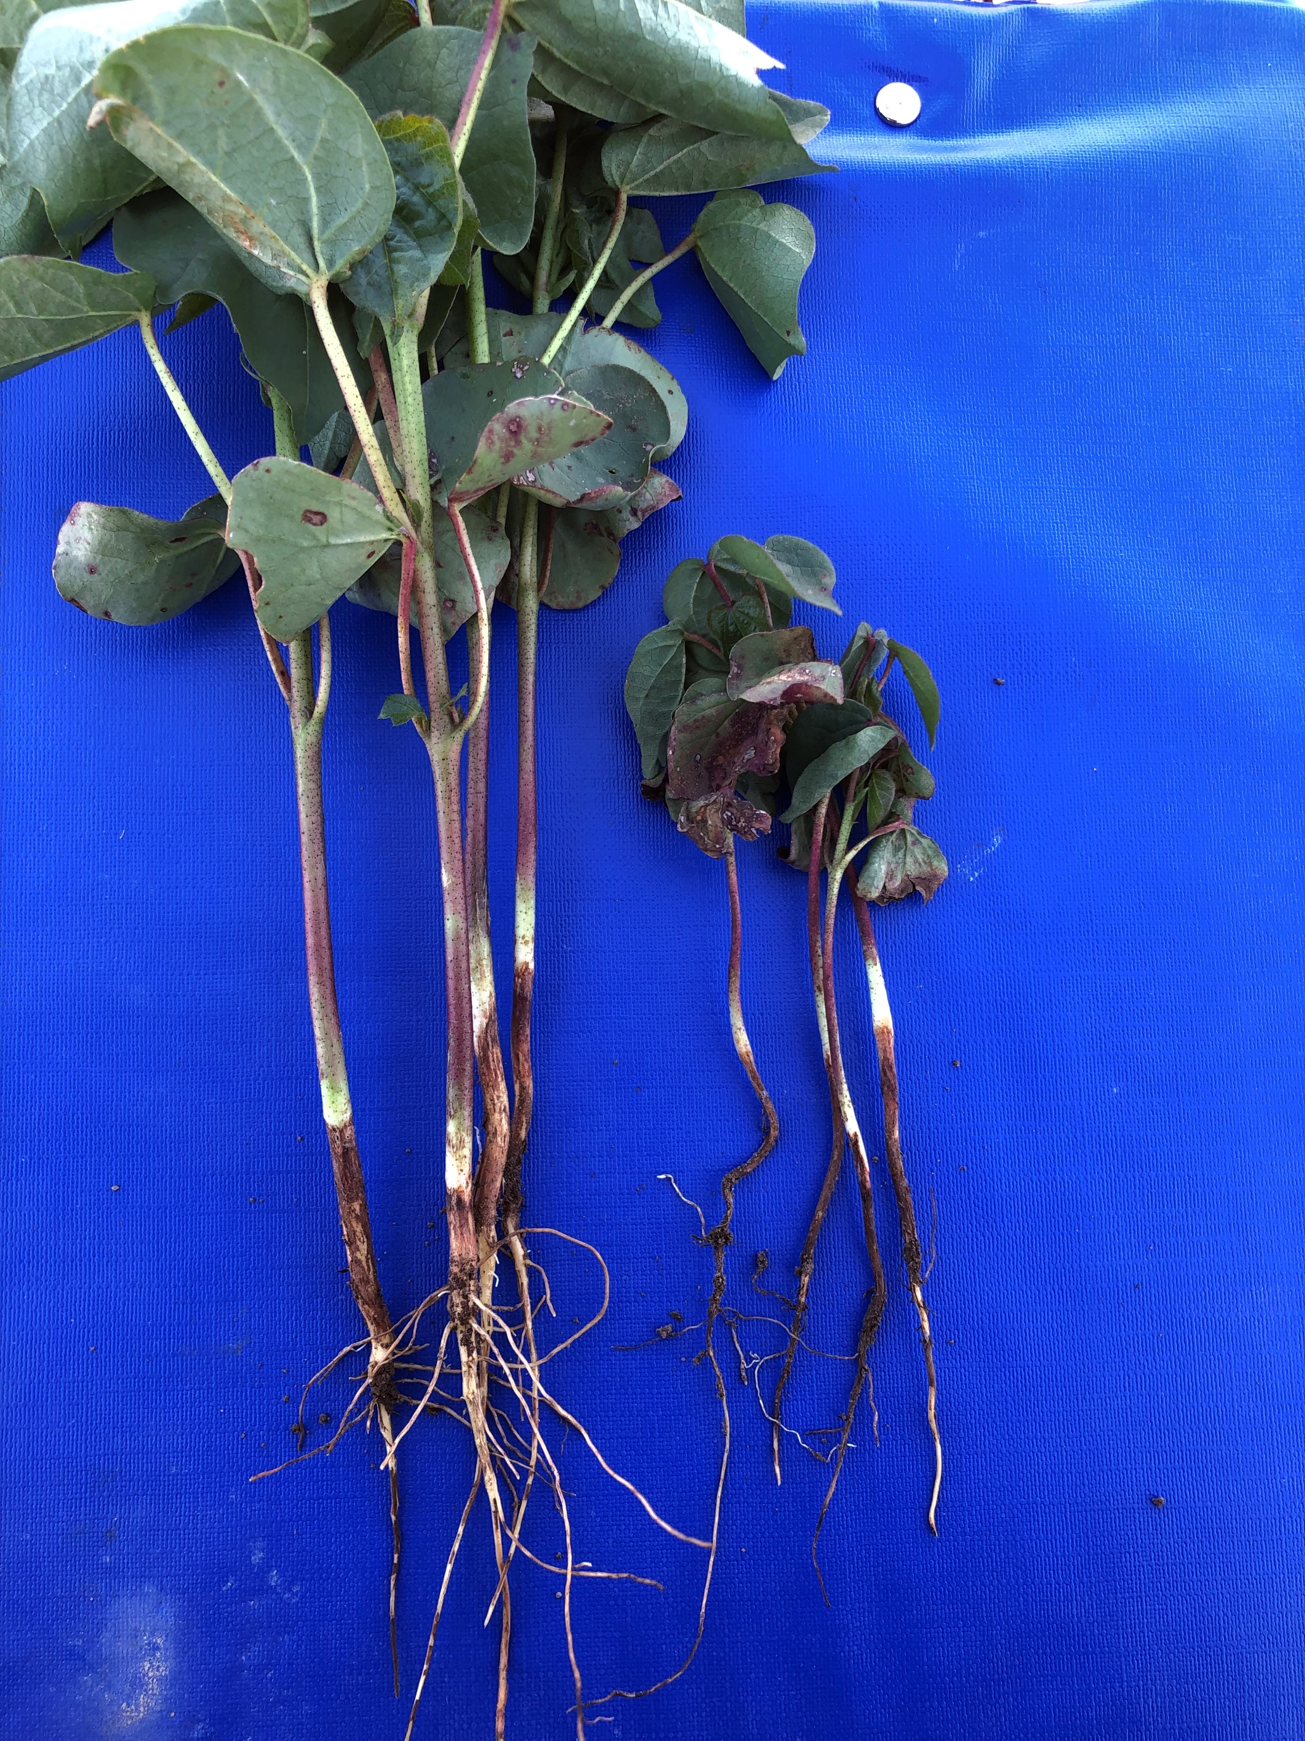
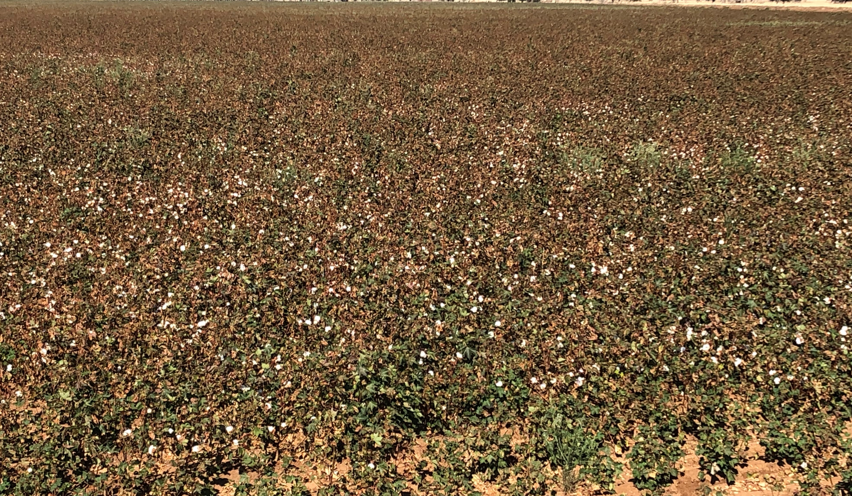
About me
Completed PhD in Pythium in ginger
Short year of postdoc in avocado pathology
Join NSW DPI for cotton pathology since 2017
About cotton diseases
Most fungal diseases: Alternaria, Berkeleyomyces, Fusarium, Verticillium, etc.
No bacteria related disease at moment
Bunch top only prevalent this 2022/23 season
Reniform nematode only detected in central QLD

Slide 3
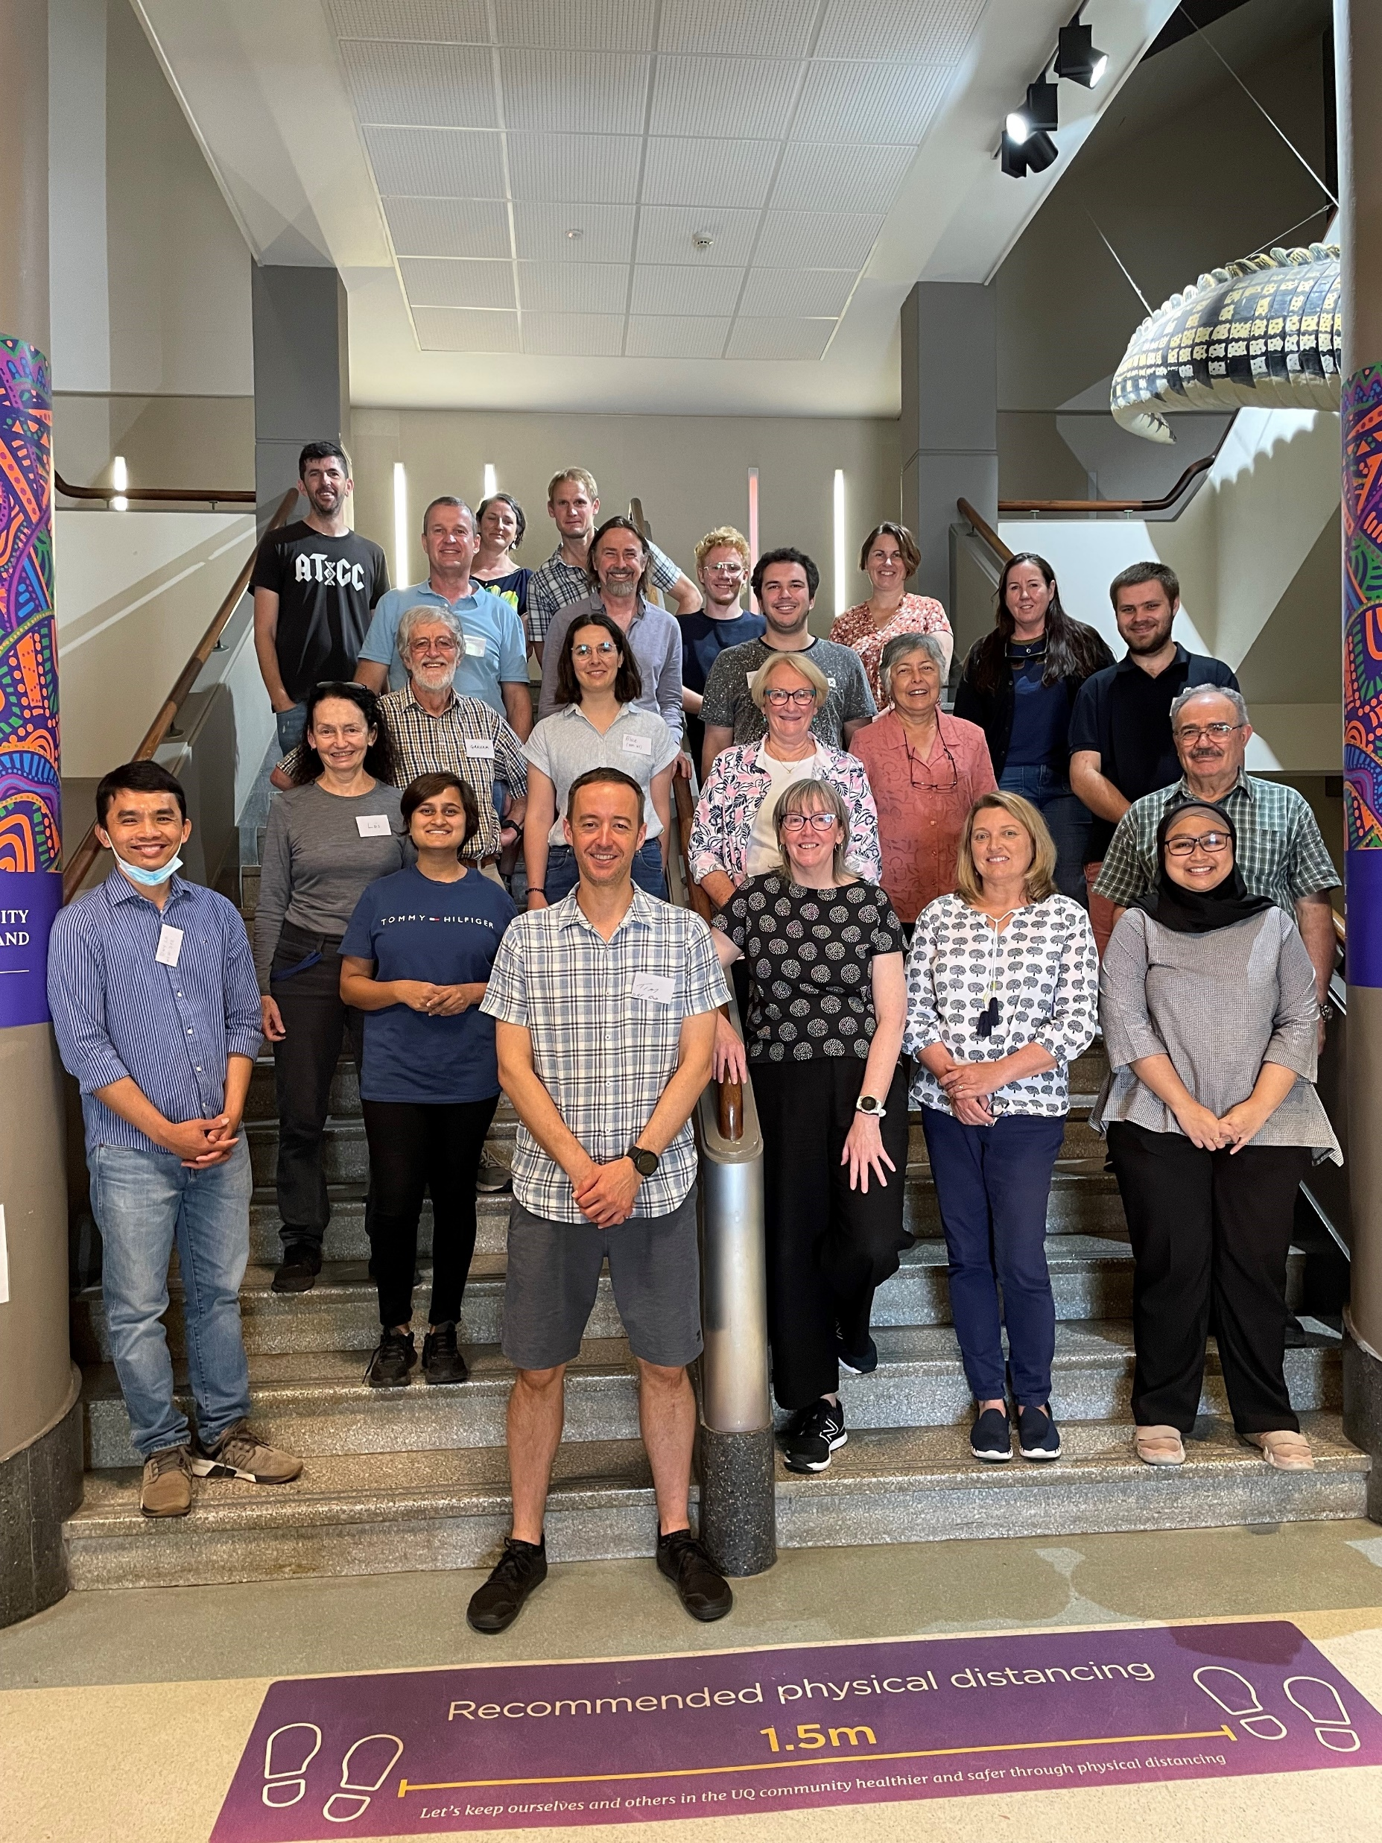
Learning experience
DPI hierarchy approvals up to DDG
The host, Dr. Graham Stirling accepted with one condition
The 1st trip for one in one training with Graham (Oct 22)
The 2nd trip for masterclass in UQ, including molecular ID (Nov 22)
The 3rd trip for revision (Mar 23)
Masterclass attendees at UQ

Slide 4
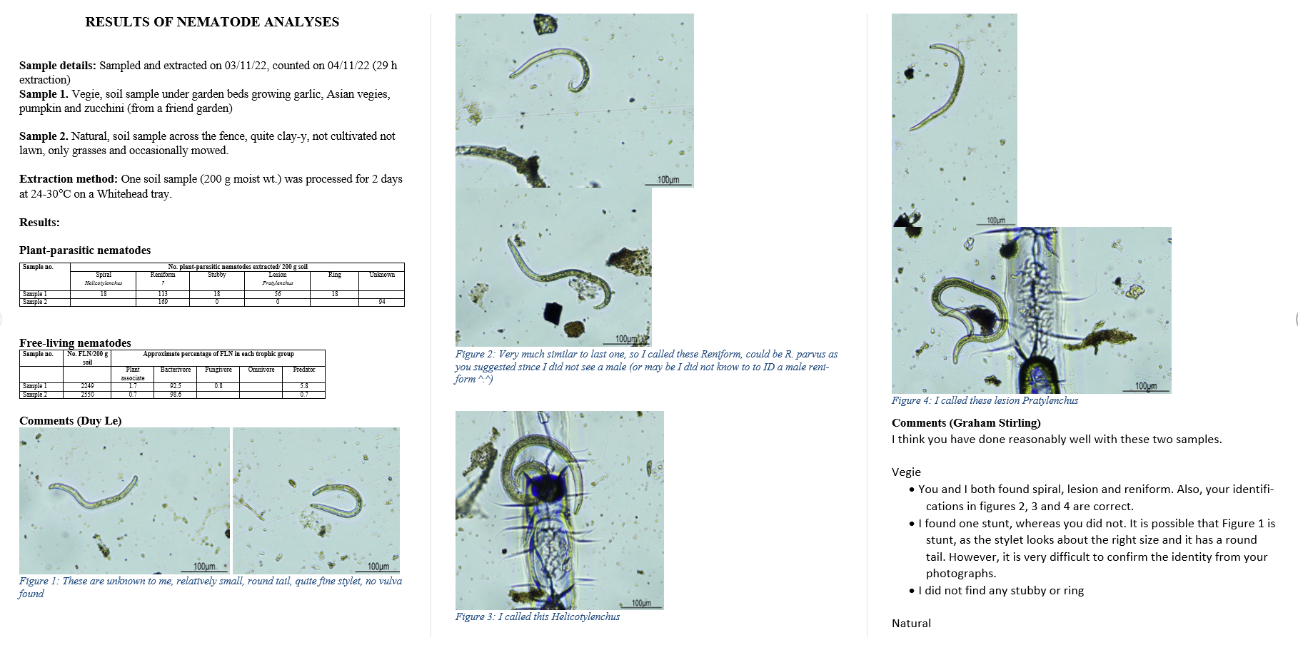
Follow up learning

Slide 5
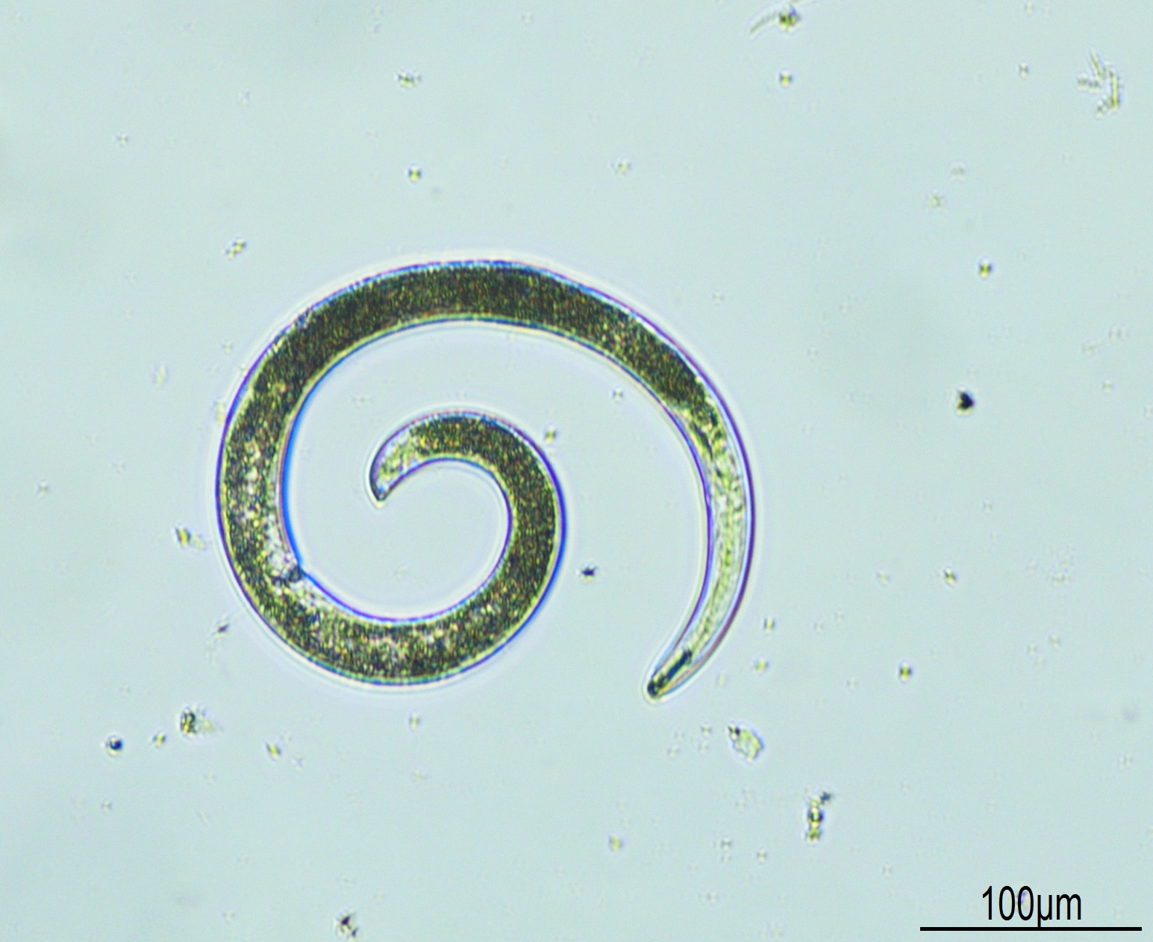
Follow up pilot research
Previously Soil samples were only collected early in the season
12 targeted sites were sampled both early and late seasons
Roots were also sampled
Common parasitic nematodes: lesion, spiral, and stunt
Mostly found in late season samples
Helicotylenchus sp.

Slide 6


Thanks
Australian DAFF
National Plant Biosecurity Diagnostic Network
NSW DPI
My host, Dr Graham Stirling
My colleagues
Contact me at:
duy.le@dpi.nsw.gov.au or for some updates on

